Slide 1
Genesis Quiz The Second
June 18

Slide 2
When the “stolen” cup is found in Benjamin’s sack of grain, which brother offers to be a slave in Benjamin’s place?
Judah (Gen. 44:16-34)

Slide 3
Who was Issachar’s mother?
Leah (Gen. 35:23)

Slide 4
What was Rachel’s Maid’s name?
Bilhah (Gen. 30:1-4)

Slide 5
What was the second bird that Noah sent from the ark?
A DOVE. (Gen. 8:8)

Slide 6
Which patriarch is specifically mentioned in the book of Genesis As giving a 10% tithe?
Jacob. We know Abraham gave 10% also, but that specific fact is in Hebrews not Genesis. (Gen. 14: 18-20, Heb. 7:1-2, Gen. 28:20-22)

Slide 7
How long was Joseph in Prison?
He was in prison for two years. (Gen. 41:1)

Slide 8
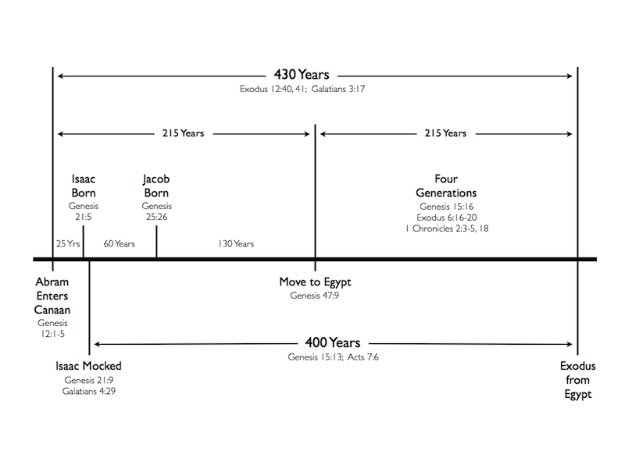
How many years elapsed between the Israelites’ entry into Egypt and the Exodus?
215 YEARS
(Gen. 15:13, Ex. 12:41, Gal. 3:17)

Slide 9
How long did Noah and his family wait on the ark before it began to rain?
Seven days (Gen. 7:1-10)

Slide 10
How long DID Jacob serve with Laban?
20 Years (Gen. 31:41)

Slide 11
Who was the second oldest man who ever lived? How old was he?
Jared. He lived 962 years. (Gen. 5:20)

Slide 12
Abraham appealed to God on behalf of Sodom, asking that God not destroy the city for the sake of the righteous living there. How many people did he bargain down to?
10 people (Gen. 18:32)

Slide 13
Whose idea was it to throw Joseph into a pit rather than kill him?
Rueben suggested this, because he wanted to return Joseph to their father. (Gen. 37:21-22)

Slide 14
Who were the “Nephilim”?
The word is translated “giants” in the KJV, but probably referred to a group that was violent and thus to be feared. (Gen. 6:4)

Slide 15
Who was Asher’s mother?
Zilpah, Leah’s handmaid (Gen. 35:26)

Slide 16
How old was Noah when the flood took place?
The flood occurred in Noah’s 600th year. (Gen. 7:11)

Slide 17
What does “Jehovah-Jirah” mean?
Jehovah will provide. (Gen. 22:14)

Slide 18
Who was Simeon’s mother?
Leah (Gen. 35:23)

Slide 19
Whose idea was it to sell Joseph as a slave?
It was Judah’s plan. He wasn’t sure that he actually wanted to murder his brother in cold blood, though he wanted Joseph out of the way. (Gen. 37:26-27)

Slide 20
How long did Seth live?
YEARS (Gen. 5:8)

Slide 21
Who was Joseph’s eldest son?
Manasseh (Gen. 41:51)

Slide 22
IN the seventh month, on the 17th day of the month, the Ark came to rest on the mountain. How long before the mountain tops were actually seen?
About two and a half months. Specifically, on the 1st day of the 10th month. (Gen. 8:5)

Slide 23
Who was Gad’s mother?
Zilpah, Leah’s handmaid (Gen. 35:26)

Slide 24
To what do the brothers attribute their harsh treatment when they go buy grain in Egypt?
To their guilt regarding their treatment of Joseph. (Gen. 42:21)

Slide 25
The first bird that Noah sent forth was what?
A RAVEN (Gen. 8:7)

Slide 26
What group of people originated with Lot’s Eldest daughter?
The Moabites (Gen. 19:37)

Slide 27
How were Isaac and Rebekah related?
They were first cousins. Rebekah was the daughter of Nahor, Abraham’s brother. (Gen. 24:15)

Slide 28
Who was Seth’s son?
Enos (Gen. 5:6)

Slide 29
How old was Joseph when he became the second ruler of Egypt?
30 YEARS OLD (Gen. 41:46)

Slide 30
Who was Joseph’s second son?
Ephraim (Gen. 41:52)

Slide 31
Did the raven that Noah sent from the ark come back?
Not exactly. It “went forth to and fro, until the waters were dried up from off the earth.” (Gen. 8:7)

Slide 32
Terah, Abram’s father, died in what city on the way to canaan?
HARAN (Gen. 11:32)

Slide 33
Of what did Joseph accuse his brothers when they came to buy grain from Egypt?
Of being spies. (Gen. 42:9)

Slide 34
How long was Noah’s family on the ark in total?
One year and seventeen days. (Gen. 7:6-11; 8:13-14)

Slide 35
What group of people originated with Lot’s Younger daughter?
The Ammonites (Gen. 19:38)

Slide 36
Melchizedek was king of where?
SALEM (Gen. 14:18)

Slide 37
When he left HARAN, after the death of his father Terah, where did Abram go?
The Land of Canaan, technically Sichem in the plain of Moreh. (Gen. 12:5-6)

Slide 38
How many chapters are there in Genesis?
Fifty chapters

Slide 39
Who did Pharaoh give Joseph as his wife?
Asenath, the daughter of Potipherah priest of On. (One of the highest families in the land.) (Gen. 41:45)

Slide 40
Who was Dan’s mother?
Bilhah, Rachel’s handmaid (Gen. 35:25)

Slide 41
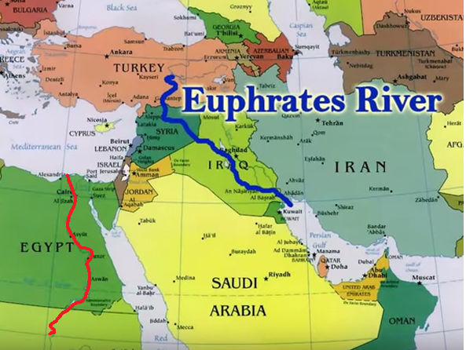
How much land did God promise to Abraham? (What were the bounds of it?)
Everything from the Nile River to the Euphrates River. (Gen. 15:18)

Slide 42
What test did Abraham’s servant use to find Isaac a wife?
That the woman of whom he would ask a drink would consent and also offer to water his camels. (Gen. 24:14)

Slide 43
How does Joseph treat his brothers when they come to Egypt to buy grain?
He throws them in jail for three days, then says that one of them must remain while the others go to fetch Benjamin. (Gen. 42:17-20)

Slide 44
Who was Levi’s mother?
Leah (Gen. 35:23)

Slide 45
How long did Sarah Abraham’s wife live?
127 YEARS (Gen. 23:1)

Slide 46
The second time that Noah sent the dove, what did it bring back?
An olive leaf (Gen. 8:11)

Slide 47
What was Leah’s Maid’s name?
Zilpah (Gen. 30:9)

Slide 48
Who was the first polygamist recorded in the Bible?
Lamech, a descendant of Cain (Gen. 4:19)

Slide 49
Who was Naphtali’s mother?
Bilhah, Rachel’s handmaid (Gen. 35:25)

Slide 50
How many years of famine were yet to go when Joseph invited his father to move to Egypt?
Five years. (Gen. 45:6)

Slide 51
How many men did Esau bring with him to meet his brother?
400 men (Gen. 33:1)

Slide 52
What did Rachel name her second son? (Before it was changed by his father.)
Benoni (Gen. 35:18)

Slide 53
How much money did Joseph’s brothers get from selling him?
Twenty pieces of silver (Gen. 37:28)

Slide 54
To what region of Egypt did Jacob and his family move under JOSEPH’S RULE?
The Land of Goshen in the Nile delta. (Gen. 45:10)

Slide 55
Which brother is left as a hostage in Joseph’s care?
Simeon (Gen. 42:24)

Slide 56
What punishment did Judah intend to inflict on Tamar, his daughter-in-law, when she was found to be pregnant without a husband?
He said “let her be burnt.” (Gen. 38:24)

Slide 57
What two Egyptian officers did Joseph encounter in Prison?
Pharaoh’s butler, sometimes translated “cupbearer,” and Pharoh’s baker. (Gen. 40:1-3)

Slide 58
What happened to the two Egyptian officers Joseph encountered in Prison? How long did it take?
After three days the butler was restored and the baker was executed. (Gen. 40:1-3)

Slide 59
What special occasion was involved in the resolution of the Butler’s and Baker’s cases?
It was Pharaoh’s birthday. At the feast the sentences were carried out. (Gen. 40:20)

Slide 60
Who was Zebulun’s mother?
Leah (Gen. 35:23)

Slide 61
What name did Pharaoh give Joseph?
Zaphnathpaaneah (Gen. 41:45)

